Slide 1

ASP.NET Core Razor Pages
ASP.NET Core 2.2, Razor Pages, Razor Class Libraries
SoftUni Team
Technical Trainers
Software University
http://softuni.bg

Slide 2
Table of Contents
ASP.NET Core 2.2
New Features
Migrating to ASP.NET Core 2.2
Razor Pages
Essentials
Simple syntax
Razor Pages Routing
Route Constraints
Razor Class Libraries
RCL Essentials

Slide 3
Have a Question?
sli.do #csharp-web

Slide 4

ASP.NET Core Latest Changes
What's new and how to upgrade to 2.2

Slide 5
Changes in ASP.NET Core 2.0 (2017-08-14)
Razor Pages (page-focused web functionality)
ASP.NET Core metapackage (Microsoft.AspNetCore.App)
.NET Standard 2.0
IConfiguration instance is added to the services container
Logging is incorporated into the DI system by default
Automatic use of anti-forgery tokens
Automatic precompilation for views
Kestrel, authentication and identity updates and improvements
Added Single Page Application (SPA) project templates

Slide 6
Changes in ASP.NET Core 2.1 (2018-05-30)
Support for SignalR
Razor Pages support areas
Razor class libraries
Identity UI library & scaffolding
Enabling HTTPS in Kestrel
GDPR
Integration Tests (WebApplicationFactory)
IHttpClientFactory service for creating HttpClients
Descriptive web APIs (ActionResult<T>, [ApiController])
MVC compatibility version

Slide 7
What's new in ASP.NET Core 2.2
Better integration with popular Open API (Swagger) libraries including design-time checks with code analyzers (link)
Introduction of Endpoint Routing with up to 20% improved routing performance in MVC (link)
Improved URL generation with the LinkGenerator class & support for route Parameter Transformers (e.g. slugify) (link)
New Health Checks API for application health monitoring (link)
Up to 400% improved throughput on IIS due to in-process hosting support (link)

Slide 8
What's new in ASP.NET Core 2.2
Up to 15% improved MVC model validation performance (link)
Problem Details (RFC 7807) support in MVC for detailed API error results (ProblemDetails class) (link)
Preview of HTTP/2 server support in ASP.NET Core (link)
Template updates for Bootstrap 4 and Angular 6
Java client (including Android apps) for ASP.NET Core SignalR (link)
Up to 60% improved HTTP Client performance on Linux and 20% on Windows (link)

Slide 9
How to update ASP.NET Core 2.1 to 2.2
Install Visual Studio 2017 version 15.9 or later and .NET Core SDK 2.2 or later
Use source control and commit the code before the changes!
If you use global.json file update the sdk version to "2.2.100"
Update Target Framework Moniker (TFM) to
<TargetFramework>netcoreapp2.2</TargetFramework>
Update all Microsoft.* packages to version 2.2
Update the compatibility version in Startup.ConfigureServices to Version_2_2
Adopt the IIS in-process hosting model with
<AspNetCoreHostingModel>InProcess</AspNetCoreHostingModel>
Recreate the scaffolded identity pages

Slide 10

@Razor
Razor Pages
Making page-focused scenarios easier to develop

Slide 11
Razor Pages
Apart from MVC, ASP.NET Core provides another approach
Enter Razor Pages! An Model-View-ViewModel-like framework
Razor Pages are similar to View Components
Model & Controller code is included in the Page itself
Enables two-way data binding and simpler development
Perfect for simple applications
With read-only functionality, or simple data input
The Single Responsibility is strong in this one

Slide 12

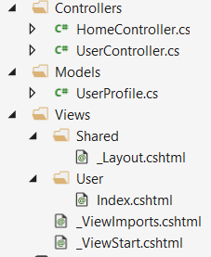
The MVC Approach
public class UserProfile
{
public string FirstName { get; set; }
public string LastName { get; set; }
}
@model UserProfile
<h1>Welcome</h1>
<p>Hey @Model.FirstName!</p>
public class UserController : Controller
{
public IActionResult Index()
{
// This would normally be extracted from the database
var model = new UserProfile
{
FirstName = "Jon",
LastName = "Hilton"
};
return base.View(model);
}
}

Slide 13
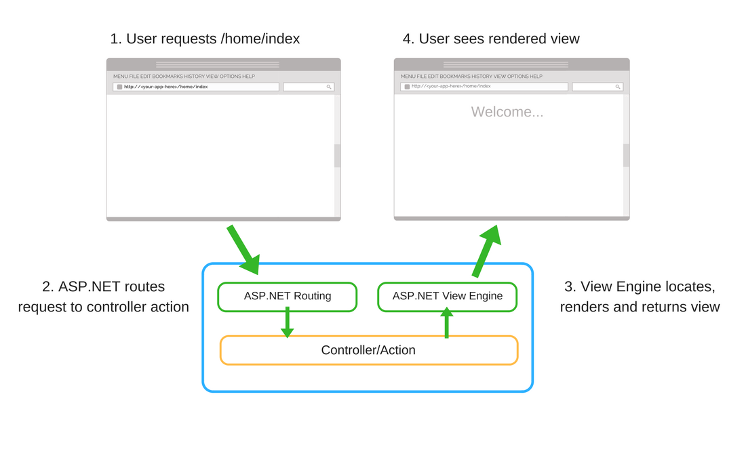
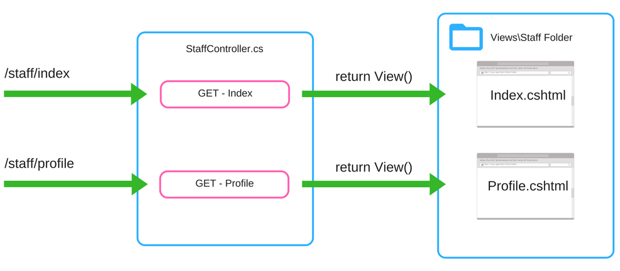
The MVC Approach

Slide 14
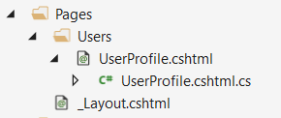
The Razor Pages Approach
public class UserProfileModel : PageModel
{
public string FirstName { get; set; }
public string LastName { get; set; }
public void OnGet()
{
// This would normally be extracted from the database
FirstName = "Jon";
LastName = "Hilton";
}
}
@page
@model UserProfileModel
<h1>Welcome</h1>
<p>Hey @Model.FirstName!</p>
Every Razor Page consists of:
A View template (.cshtml), which acts as a view
A functional (.cs) file, which acts as its controller action

Slide 15
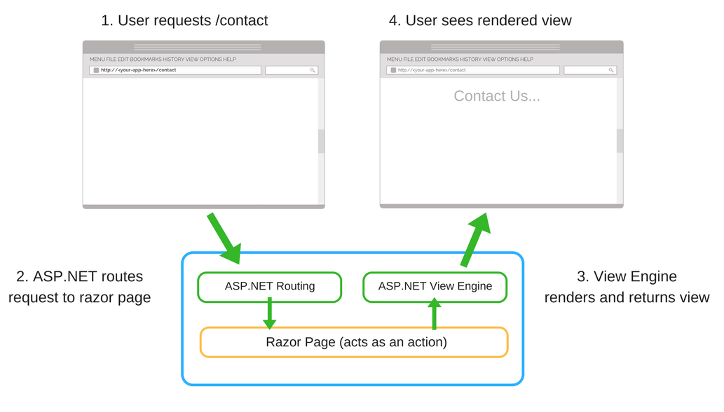
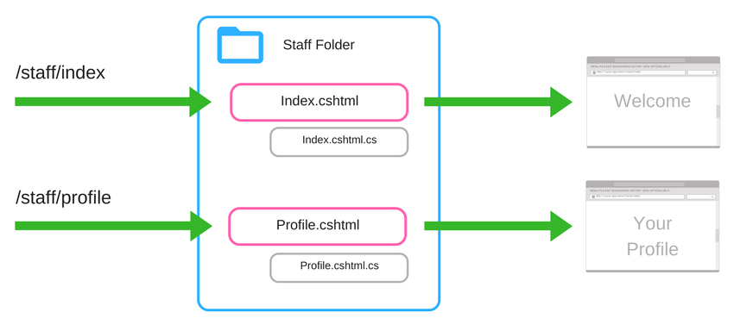
The Razor Pages Approach

Slide 16
MVC vs Razor Pages
Razor Pages are simple and organized
Razor Pages makes Front-End structure more conventional
More explicit, less implicit
Razor pages are suitable for pure, page-oriented cases
About, Contact pages, etc.
MVC is a bit more complex
Heavy architecture and code structure
MVC leaves a lot of freedom
For example, some actions may lack views named after them
MVC should be used for more MVC-ish cases:
APIs, SOA, Product Catalogs, etc.

Slide 17
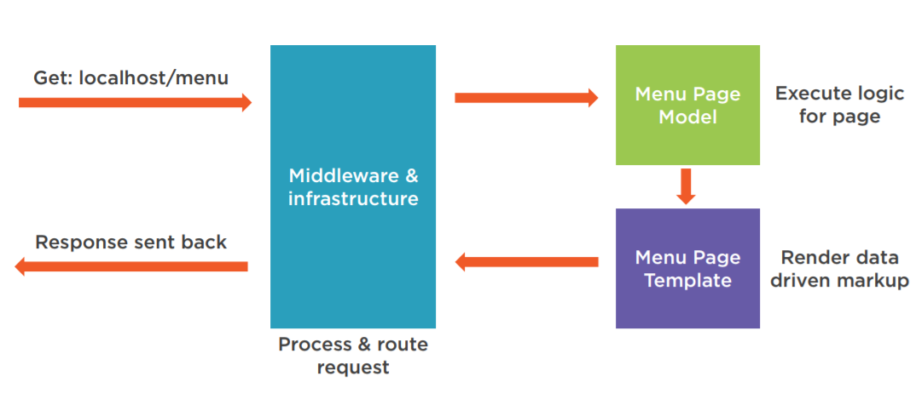
Razor Pages Request Pipeline

Slide 18


Razor Pages Form Submission
Razor Pages is very convenient for Form Data Submission
The logic is centralized in a single code component
public class UserProfileModel : PageModel
{
public string FirstName { get; set; }
public string LastName { get; set; }
public void OnGet()
{
// Run logic for loading the page and displaying it to the user
}
public void OnPost()
{
// Run logic for processing data submitted back to the Page Model
}
}

Slide 19
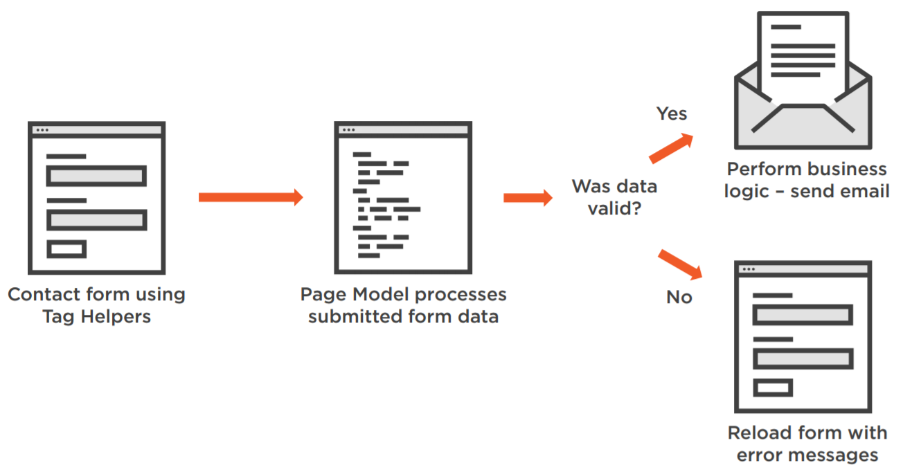
Razor Pages Form Submission

Slide 20
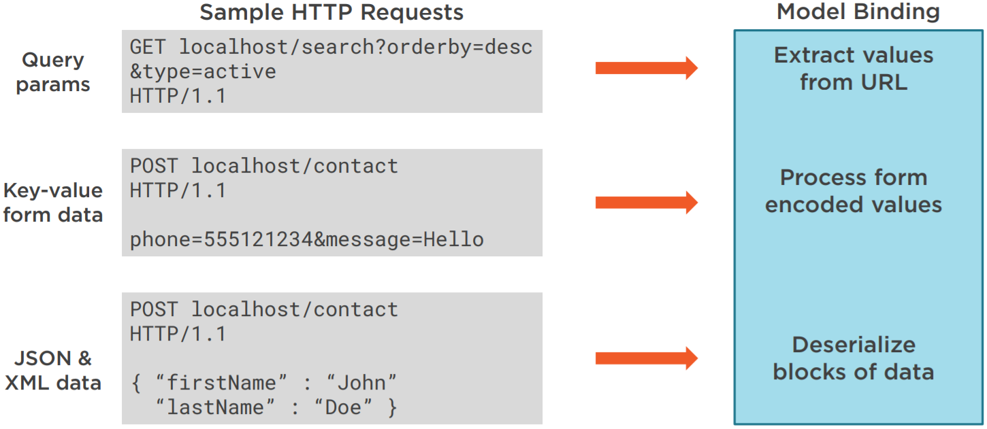
Razor Pages Form Submission
Handling request data and model binding is done differently
Depends on the context and the format of the data sent

Slide 21
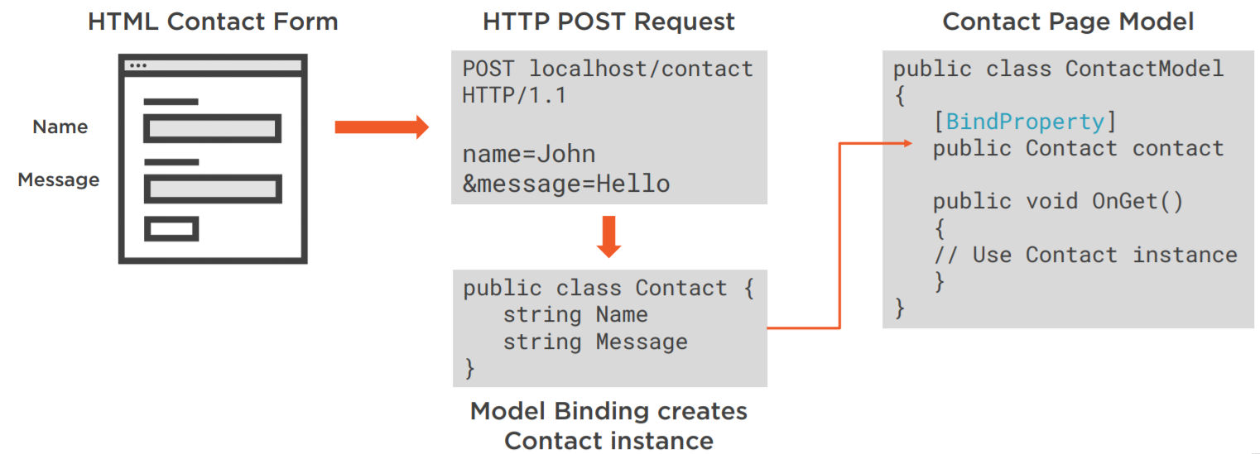
Razor Pages Form Submission
Binding Data in Razor Pages can be extracted into a separate model
As opposed to the previous examples with UserProfile
Where properties were stored in the Page’s .cs file
[BindProperty] attribute is used to bind the foreign model to the model binding mechanism of the Page

Slide 22
Razor Pages Form Submission
Binding Data in Razor Pages can be extracted into a separate model
This can also be achieved by passing the model as a parameter to the handling action
public class EditModel : PageModel
{
public void OnGet(int id)
{
// Run logic for extracting and displaying Profile with given id
}
public void OnPut(UserProfile userProfile)
{
// Run logic for processing Edit functionality on UserProfile
}
}

Slide 23

Razor Page Routing Conventions

Slide 24
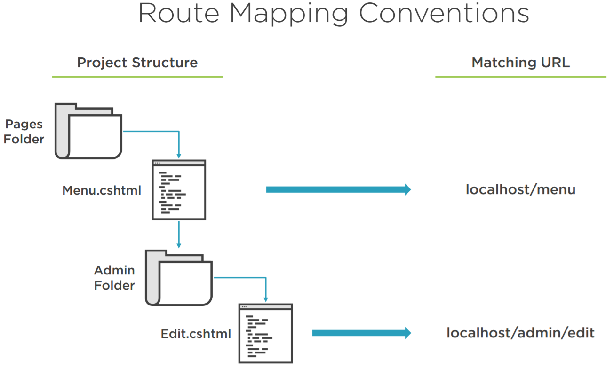
Razor Pages Routing
The Razor Pages conventional routing depends on the file structure

Slide 25
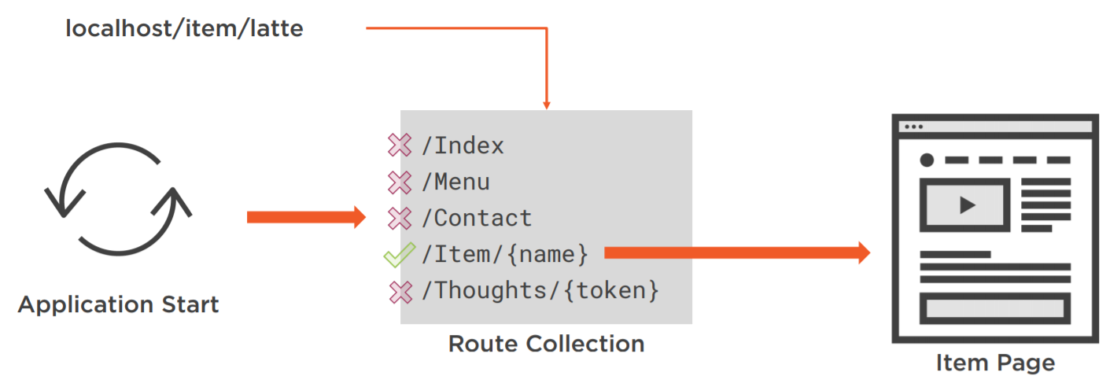
Razor Page Routing
Custom route templates are also an option in Razor Pages
@page "/users/profiles/{id}"
@model UserProfileModel
<h1>Welcome</h1>
<h1>Hey @Model.FirstName @Model.LastName!</h1>
The custom route template is passed after the @page
The custom route template can contain route parameters
NOTE: There are reserved route names, which you cannot use: "action","area","controller", "handler","page"

Slide 26
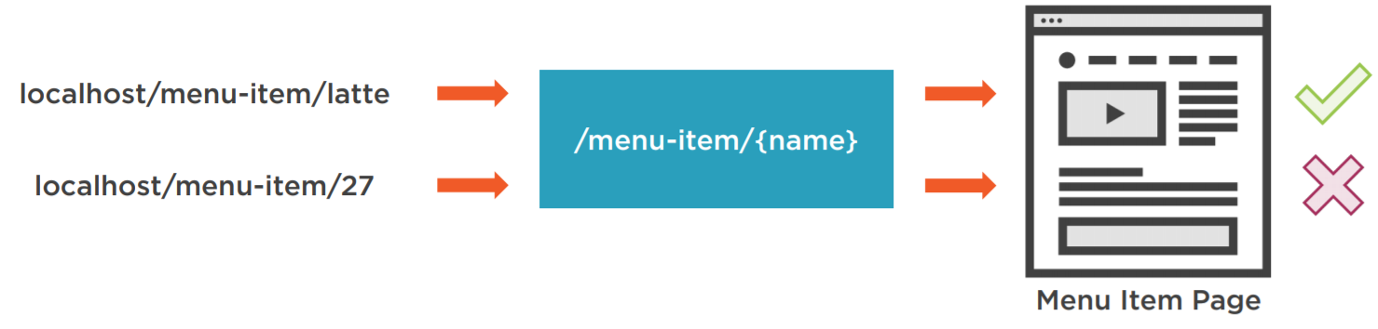
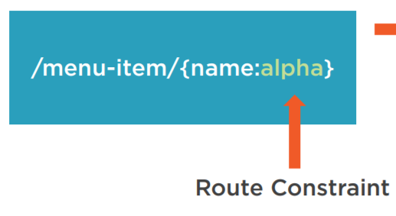
Razor Page Routing
You can also conventionalize the route parameters with your own rules
For example, we want our parameter to consist only of letters
Then we will use a route constraint
This will ensure our route parameters are in just the right format

Slide 27
Razor Page Routing
Here is a small reference of the most important route constraints
Route Constraint | Use | Example Matches
int | {id:int} | 123, -232, 5444, 10903
bool | {active:bool} | true, FALSE
decimal | {price:decimal} | -1,000.01, 49.90
guid | {id:guid} | CD2C1638-1638-72D5-…
minlength / maxlength | {filename:minlength(4)} / {filename:maxlength(8)} | file / file.db
minvalue / maxvalue | {age:min(18)} / {age:max(64)} | 19 / 63
length / range | {name:length(5,20)} / {age:range(18,64)} | File-of-base.db / 54
Alpha | {name:alpha} | Donald
regex | {sns:regex(^//d{{3,7}}$)} | 4567
required | {name:required} | Rick

Slide 28

RCL
Razor Class Libraries
Creating reusable UI

Slide 29
Razor Class Libraries
Razor components can be built into a Razor Class Library (RCL)
Razor Views, Pages, Controllers, Page Models
View Components, Data Models etc...
RCLs can be packaged and reused
Apps can include RCL and override views and pages it contains
There can be duplicate views, partials, pages etc.
In that case the Web App’s component takes precedence
RCLs can be referenced through NuGet or project reference

Slide 30
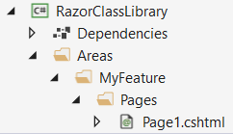
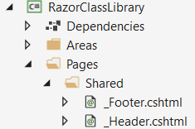

Razor Class Libraries
Razor Class Libraries are similar to ASP.NET Core Web apps by structure
It is recommended to put custom UI pieces to Areas
But you can also follow a default architecture
The second example is casually used to reference RCL content as it was part of the Web App’s Pages folder. Like an extension.
@Pages
You can see a Razor UI Class Library demo application here.

Slide 31
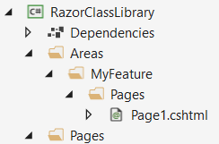
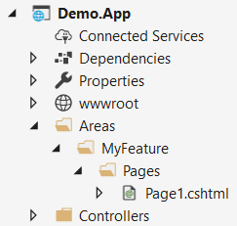
Razor Class Libraries
Razor Class Libraries content can be overridden pretty easily
As it was stated earlier, the app’s components take precedence
In the event of a conflict (duplicate components)
We want to override this page in the RCL
The app’s page is in the same area and takes precedence

Slide 32

Razor Class Libraries
Live Demonstration

Slide 33

Summary
ASP.NET Core 2.2
New Features
Migrating to ASP.NET Core 2.2
Razor Pages
Essentials
Simple syntax
Razor Pages Routing
Route Constraints
Razor Class Libraries
RCL Essentials
…
…
…

Slide 34
https://softuni.bg/trainings/courses

Slide 35













SoftUni Diamond Partners

Slide 36





SoftUni Organizational Partners

Slide 37




Trainings @ Software University (SoftUni)
Software University – High-Quality Education and Employment Opportunities
softuni.bg
Software University Foundation
http://softuni.foundation/
Software University @ Facebook
facebook.com/SoftwareUniversity
Software University Forums
forum.softuni.bg

Slide 38

License
This course (slides, examples, demos, videos, homework, etc.) is licensed under the "Creative Commons Attribution-NonCommercial-ShareAlike 4.0 International" license

